Slide 1

E-Asset Management
BY-
</CODE PREDATORS/>

Slide 2

OBJECTIVE
Asset management refers to the process of developing, operating, maintaining, and selling assets in a cost-effective manner
The E-Asset Management System is a web-based application to keep the track of several assets that can be borrowed, their availability, their location, the current browser and the asset history.
Assets Include Laptops, Books, Mobile and Devices.
The Roles Involved in the application are-
1-Administrator(maximum of one)
2-Borrowers(Employees of the Company => one or more)

Slide 3
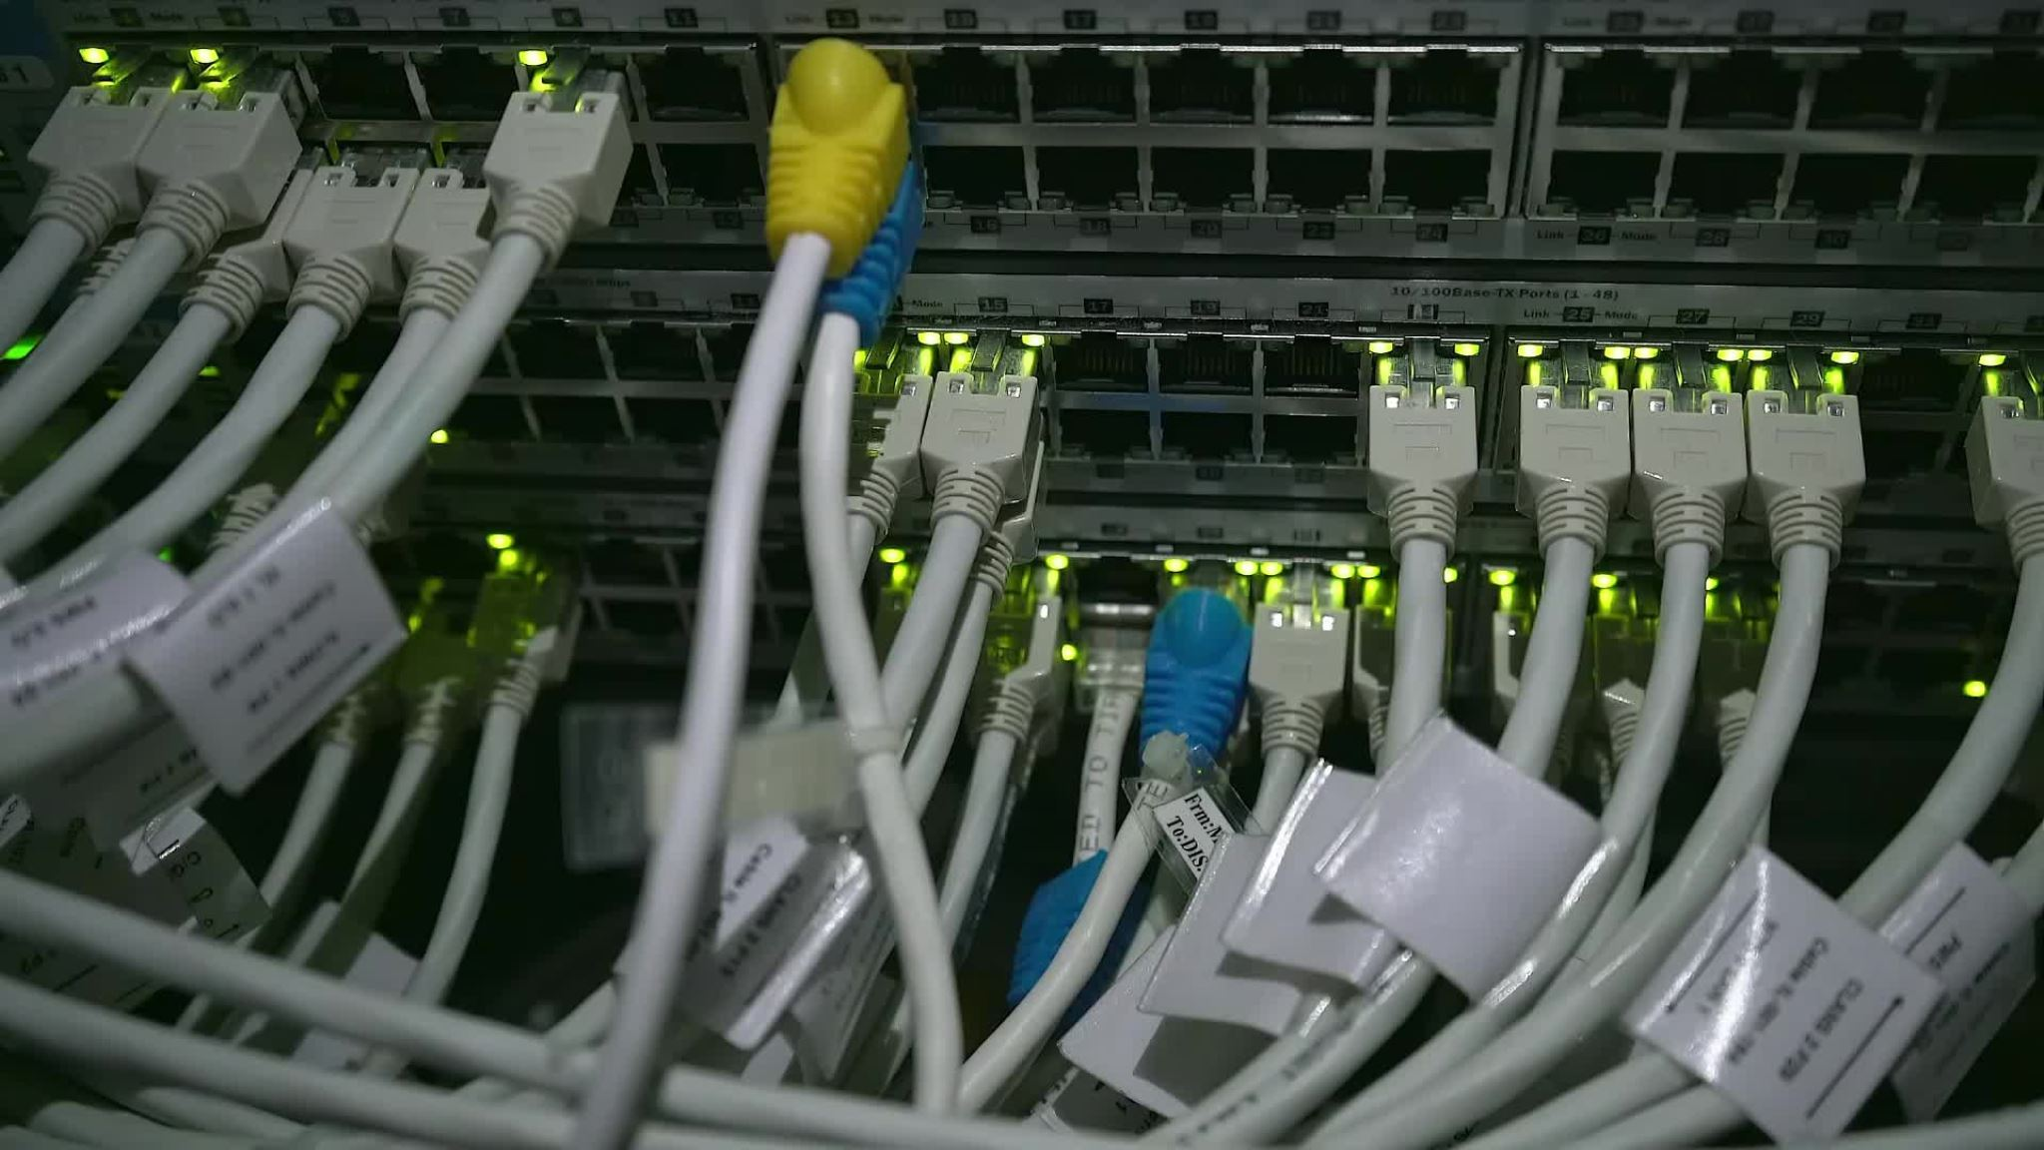
Tech-Stacks Used
a)HTML(Hyper Text Markup Language)
b)CSS(Cascading Style Sheet)
c)JSP
d)Servlet
e)Java
f)Layered Architecture
g)MySQL

Slide 4
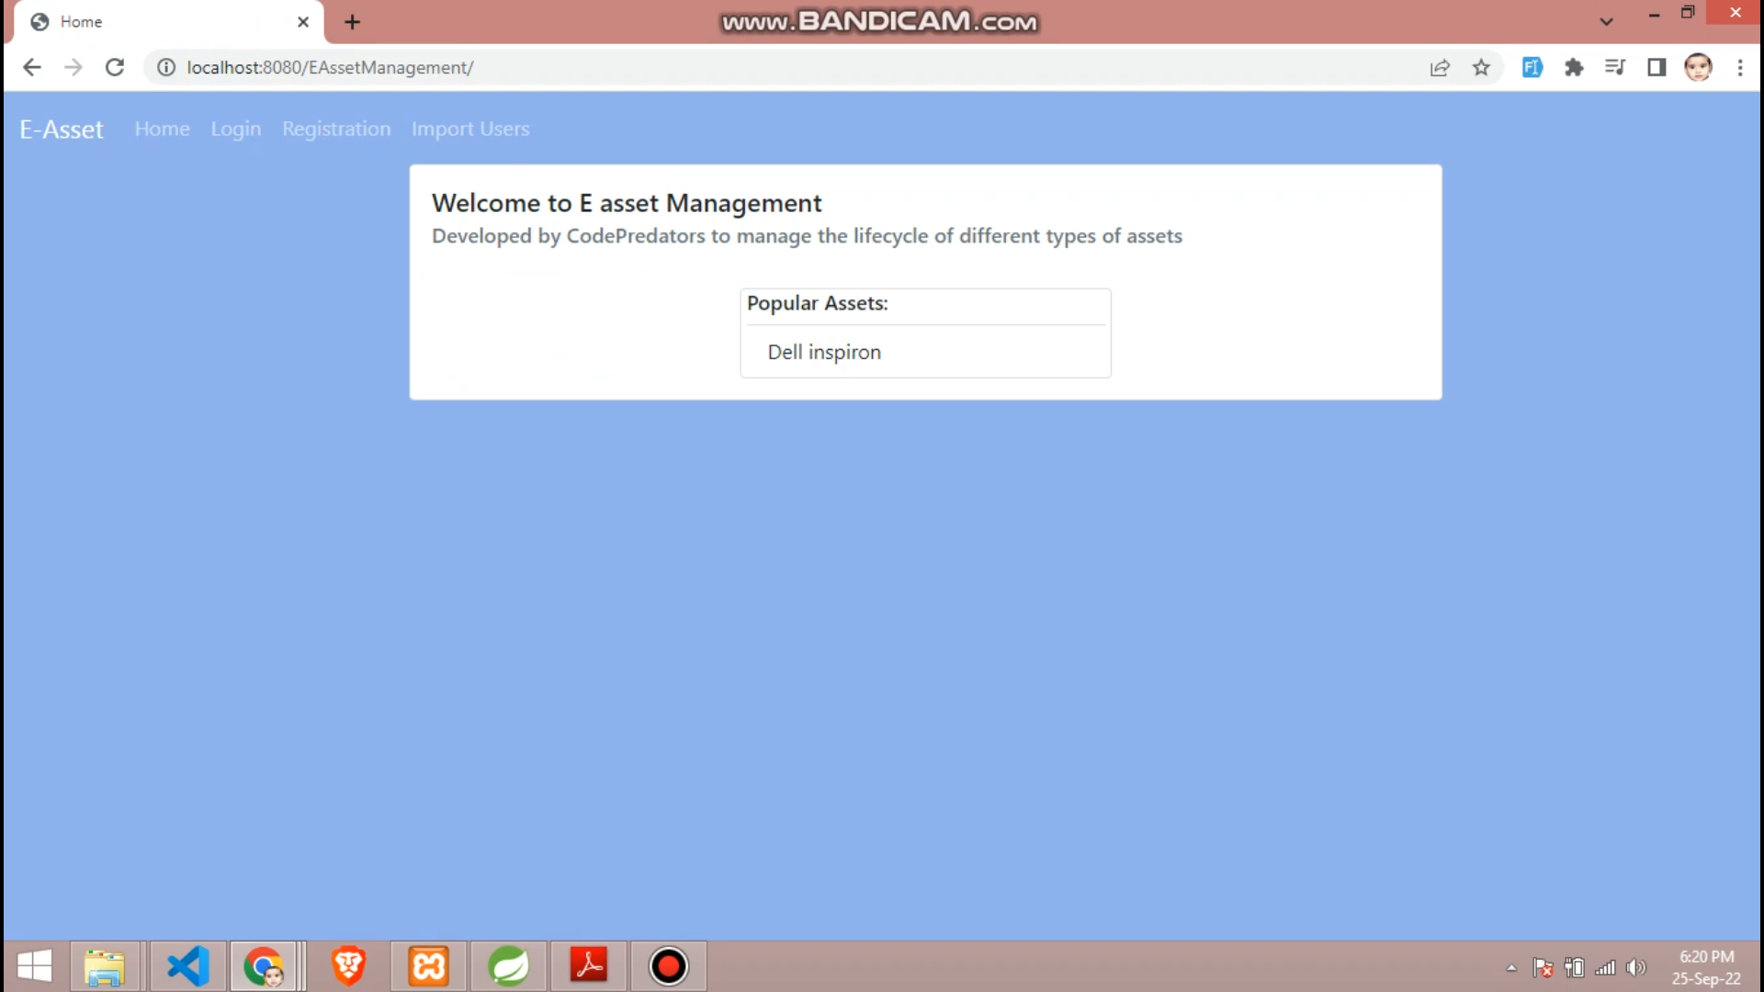
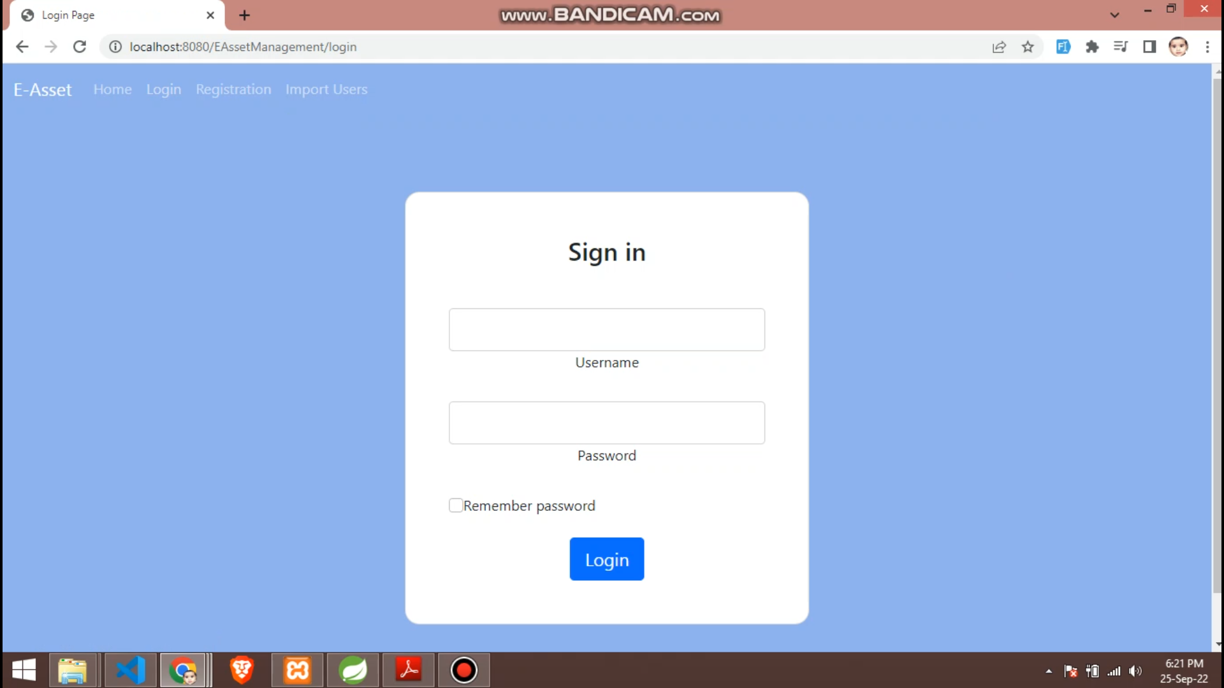

Slide 5
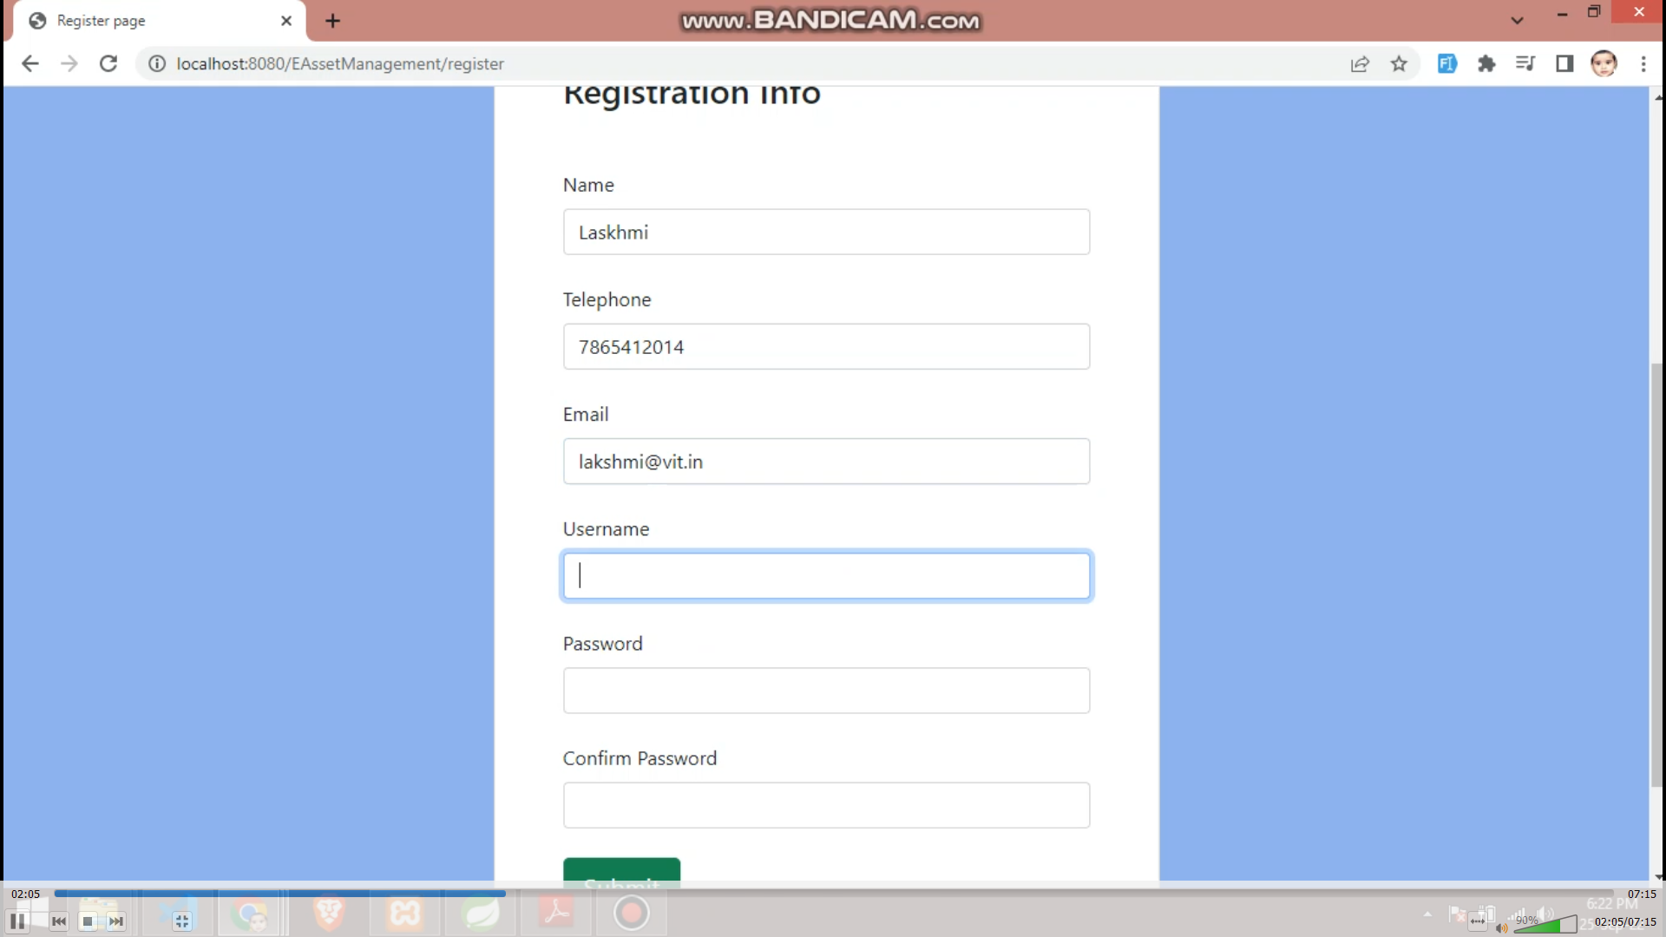
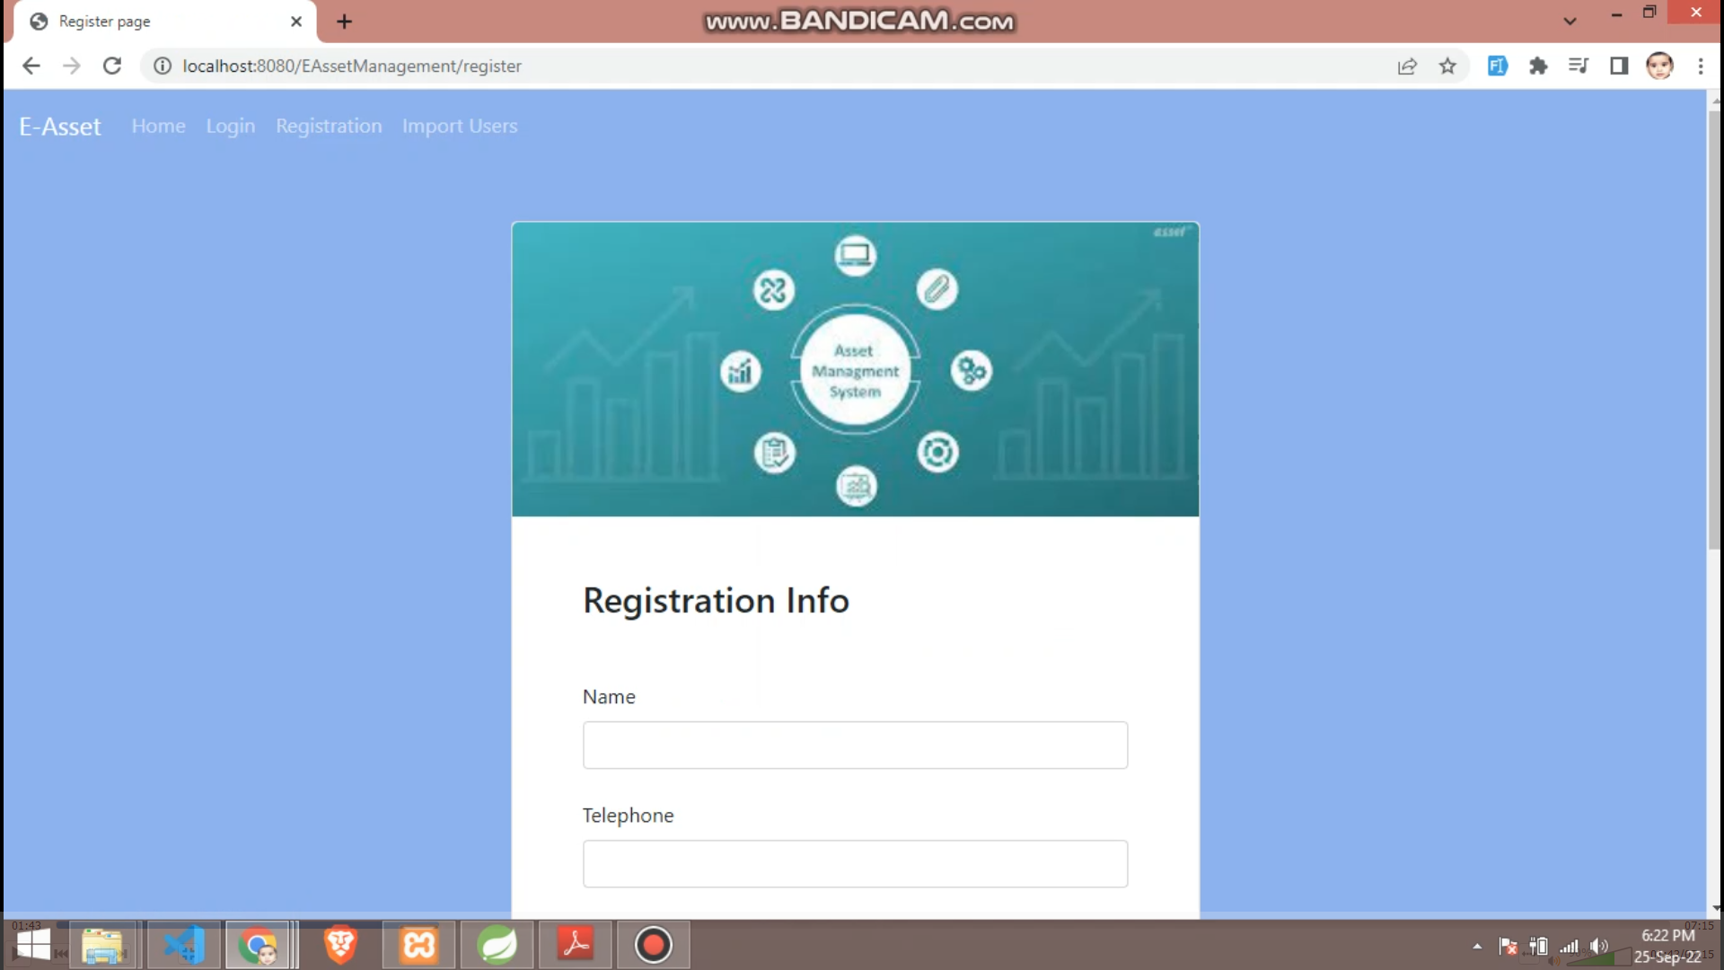

Slide 6
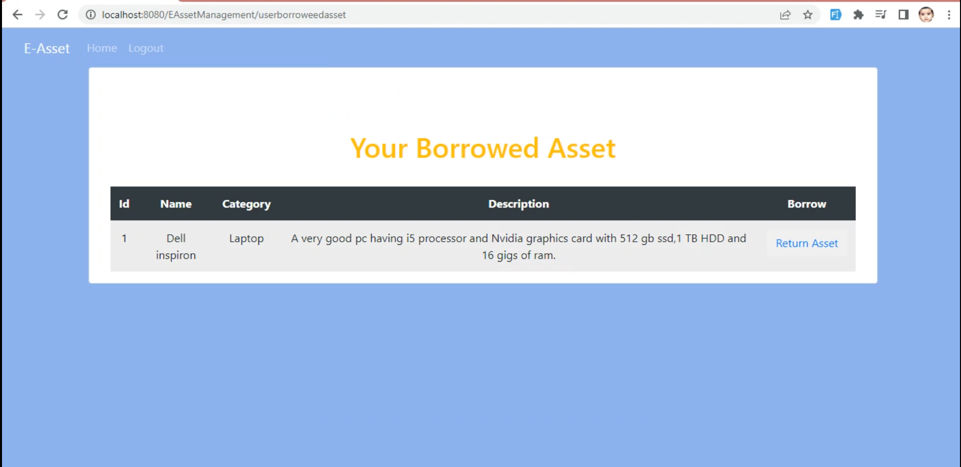

Slide 7
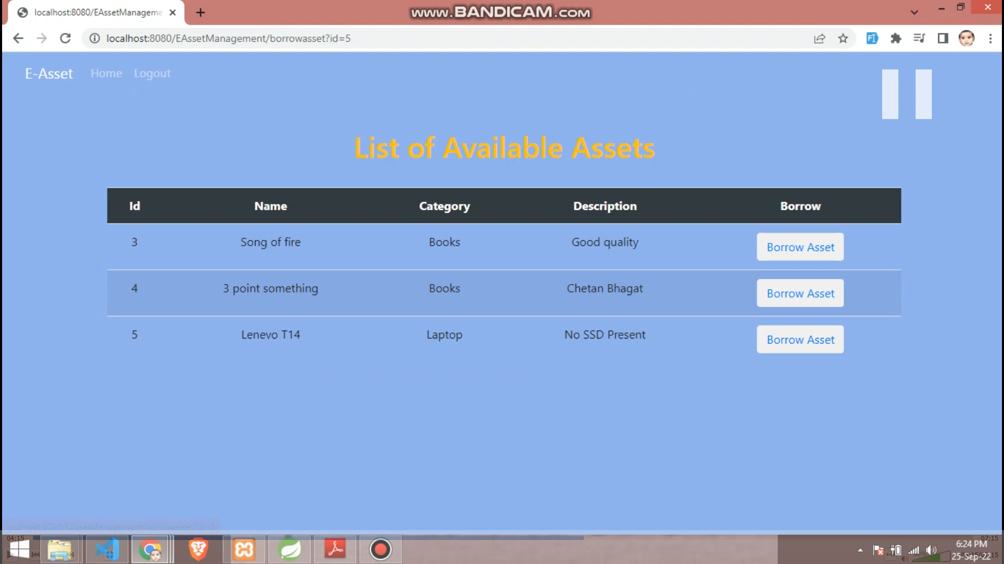

Slide 8
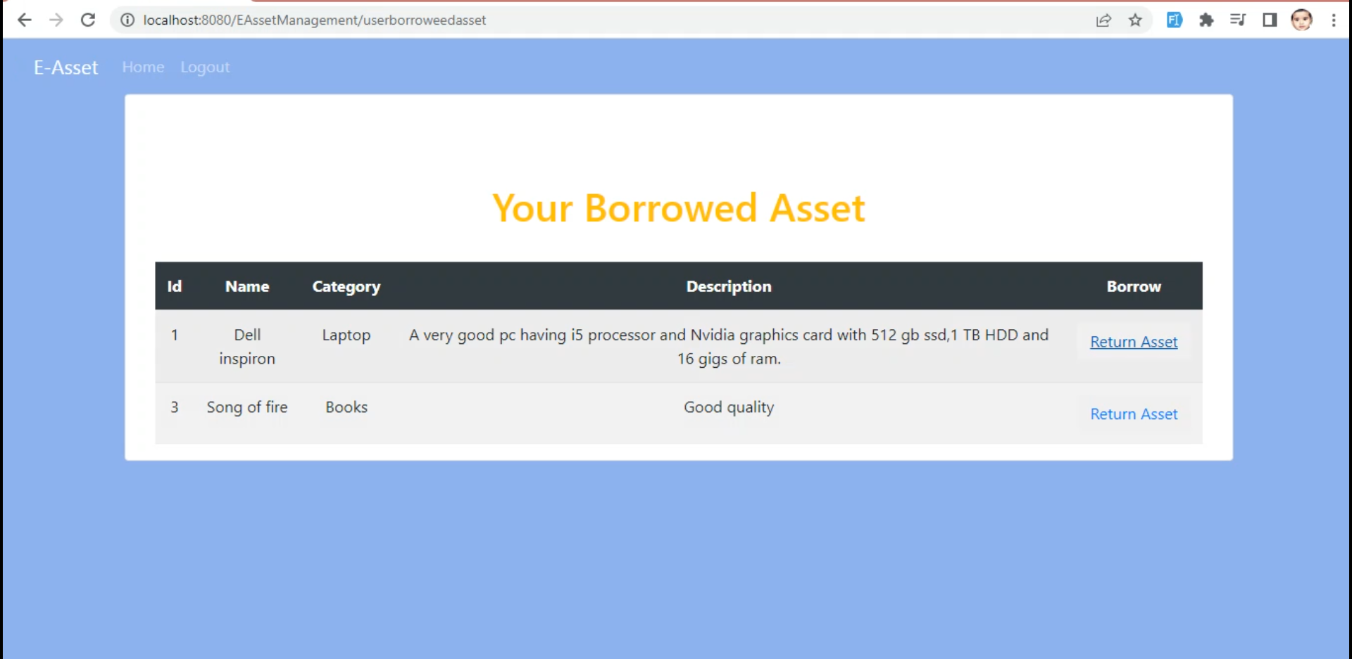

Slide 9
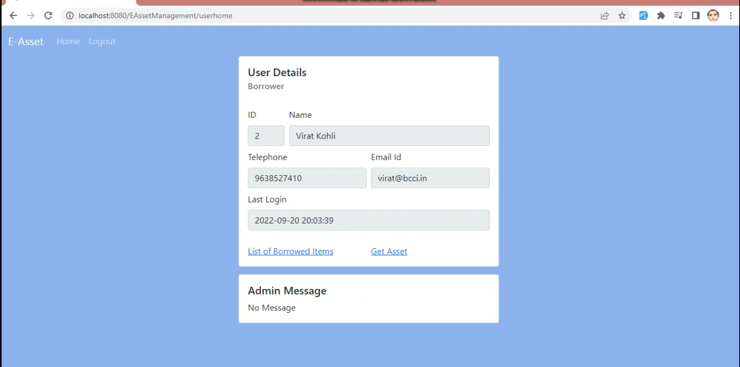

Slide 10
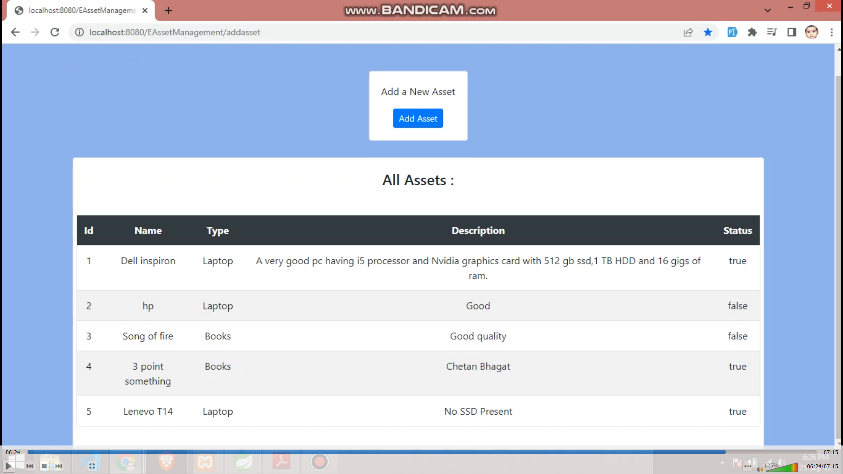

Slide 11
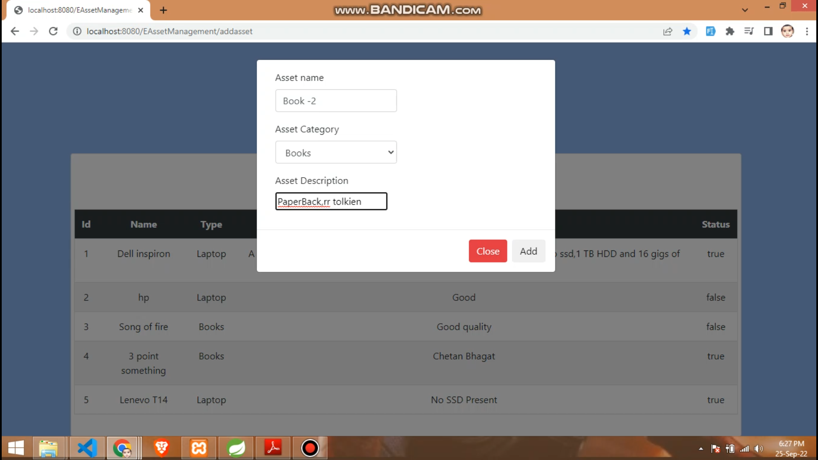

Slide 12
